Slide 1

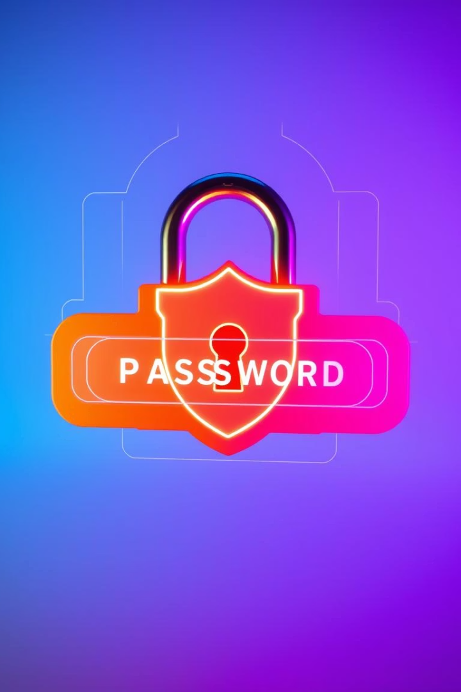

Password Strength Checker
Discover a tool designed to protect your online accounts by assessing password strength.
By Sanchit Manjarekar
samadhan bheke
Abhay Yadav
Notes:
1.7.2013
1
‹#›

Slide 2
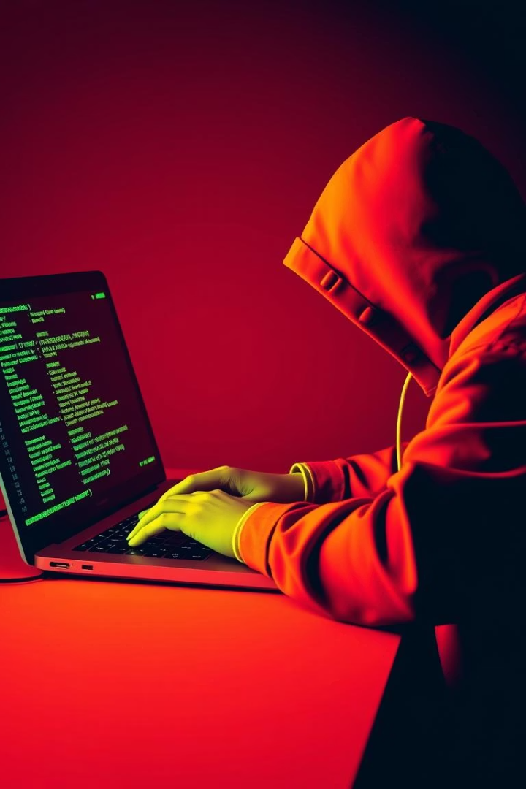


Problem: Weak Passwords = High Risk
81% of breaches stem from weak or stolen passwords (Verizon DBIR 2023).
65% of users reuse passwords across their 100+ online accounts.
"123456" remains the most common weak password (NordPass 2023).
Notes:
1.7.2013
2
‹#›

Slide 3
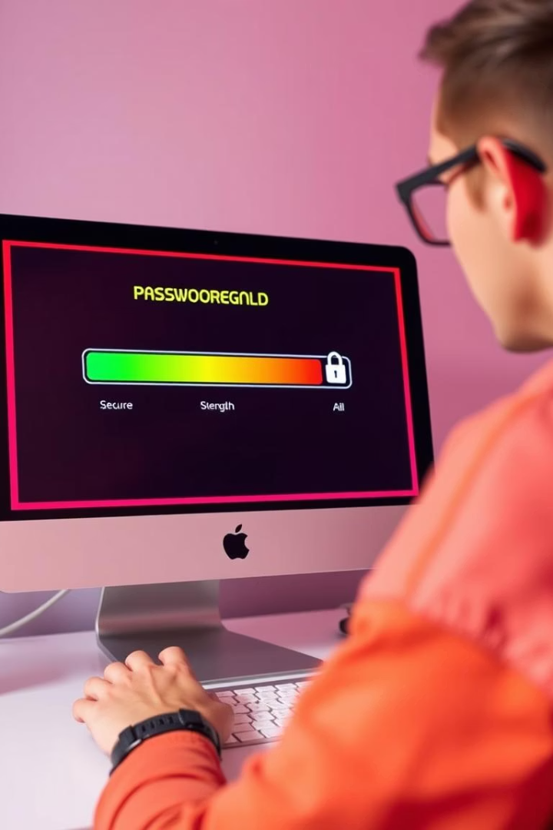

Solution: Instant Password Strength + Breach Check
Instant Evaluation
Breach Detection
Real-time strength analysis for every password entered.
Checks password against known breached databases for safety.
User Privacy
All processing occurs locally to protect your data.
Notes:
1.7.2013
3
‹#›

Slide 4
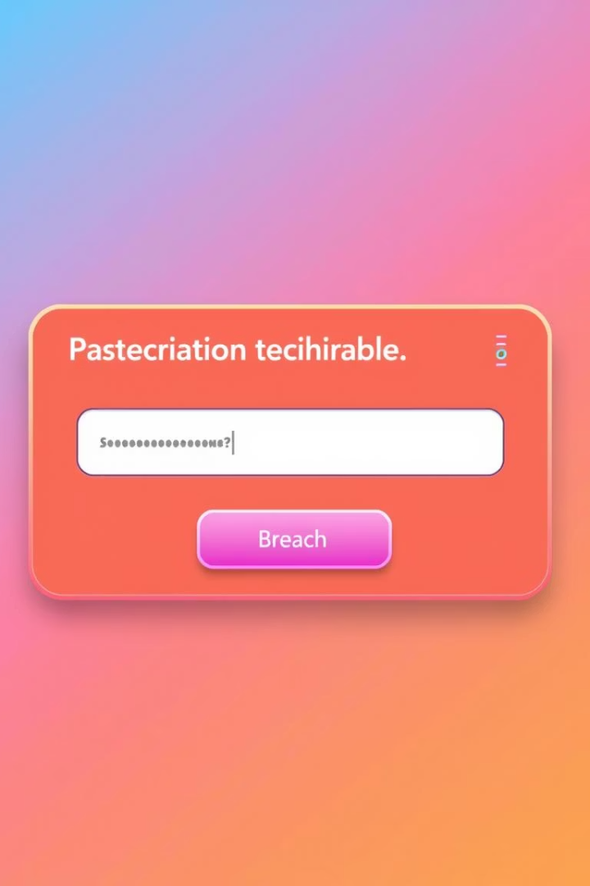

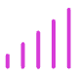

Demo: Real-time Strength Evaluation
Password Input
Type your password securely for instant feedback.
Strength Indicator
Colored bar shows if your password is weak, moderate, or strong.
Breach Alert
Instant display if your password has appeared in data breaches.
Notes:
1.7.2013
4
‹#›

Slide 5
How It Works: Regex + API + GUI
Regex Validation
Breach API
User Interface
Local Processing
Enforces length and character complexity rules.
Uses “Have I Been Pwned?” API to check compromised passwords.
Tkinter creates a simple, secure graphical interface.
All checks run on your device for full privacy protection.
Notes:
1.7.2013
5
‹#›

Slide 6

Cybersecurity Impact: Empowering Users
Best Practices
Risk Reduction
Encourages strong, unique passwords for every account.
Helps lower chances of account hacking and identity theft.
User Education
Raises awareness about the importance of password security.
Notes:
1.7.2013
6
‹#›

Slide 7
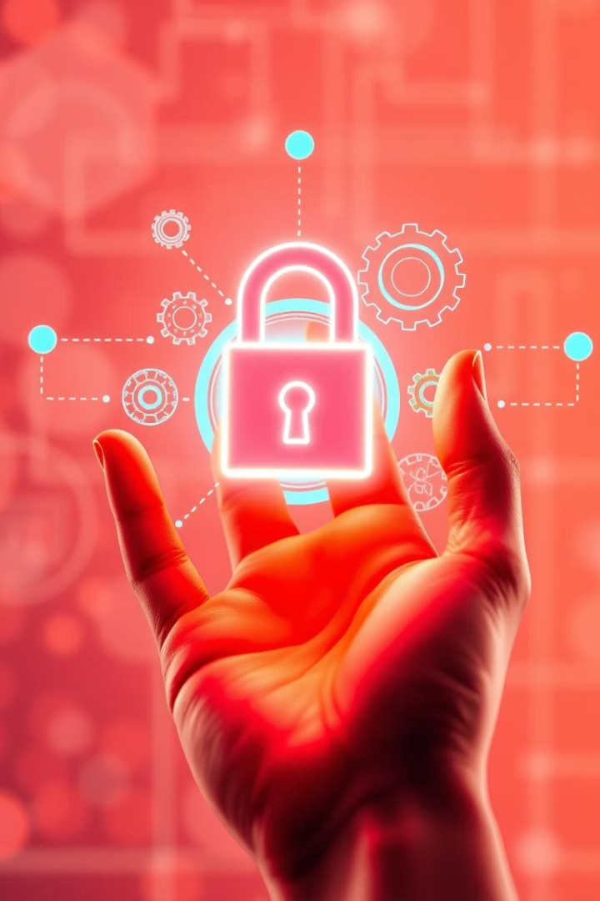

Future Work: Expanding Capabilities
Password Generator
Create strong random passwords effortlessly.
Encrypted Logs
Track password use securely to avoid reuse.
MFA Integration
Add multifactor authentication for extra security layers.
Offline Database
Allow breach checks without internet connectivity.
Notes:
1.7.2013
7
‹#›

Slide 8
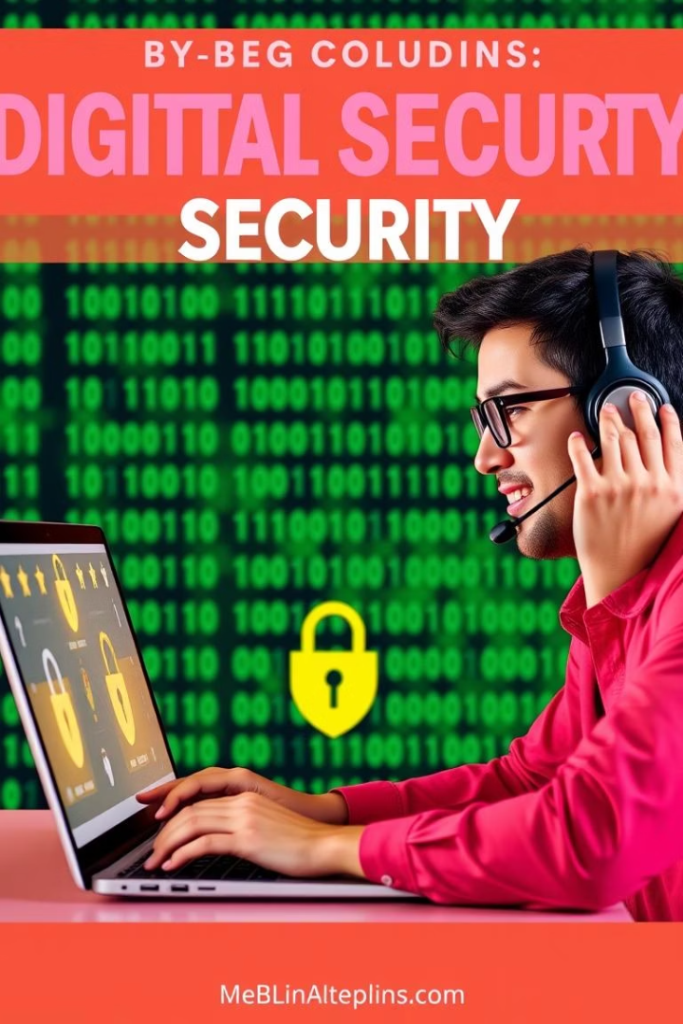
Conclusion: Take Control of Your Security
Strong passwords are critical to protecting your data.
Our tool simplifies checking password strength and safety.
Proactive actions reduce hacking risks drastically.
Notes:
1.7.2013
8
‹#›

Slide 9
THANK YOU🙏🏻

